Slide 1
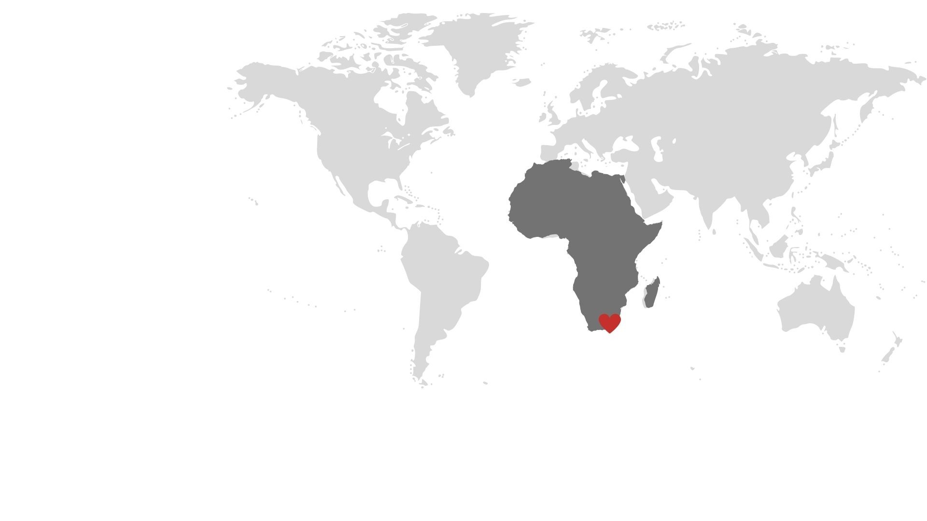
Pillars of Grace: A Personal Testimony

Slide 2
Pillars of Grace: A Personal Testimony
And I sought for a man among them
who should build up the wall
and stand in the breach before me for the land,
that I should not destroy it,
but I found none.
- Ezekiel 22:30

Slide 3
Pillars of Grace: A Personal Testimony
For God so loved the world,
that he gave his only Son,
that whoever believes in him
should not perish but have eternal life.
- John 3:16

Slide 4
Pillars of Grace: A Personal Testimony
I am the good shepherd…
My sheep hear my voice,
and I know them, and they follow me.
I give them eternal life,
and they will never perish,
and no one will snatch them out of my hand.
- John 10:14, 27-28

Slide 5
Pillars of Grace: A Personal Testimony
The man bowed his head and worshiped the LORD and said, “Blessed be the LORD, the God of my master Abraham, who has not forsaken his
steadfast love and his faithfulness toward my master.
As for me, the LORD has led me in the way
to the house of my master’s kinsmen.”
- Genesis 24:26-27

Slide 6
Pillars of Grace: A Personal Testimony
God sovereignly works in the details
to accomplish His will
and fulfill His promises.

Slide 7
Pillars of Grace: A Personal Testimony
“The Word of the LORD came to me” (Ezekiel 22)
v1-16 – the LORD uses graphic language to describe
Israel’s sinful and idolatrous behavior

Slide 8
Pillars of Grace: A Personal Testimony
“The Word of the LORD came to me” (Ezekiel 22)
v1-16 – the LORD uses graphic language to describe
Israel’s sinful and idolatrous behavior
v17-22 – the LORD explains that Israel is about to
be judged because of their pervasive impurity

Slide 9
Pillars of Grace: A Personal Testimony
“The Word of the LORD came to me” (Ezekiel 22)
v1-16 – the LORD uses graphic language to describe
Israel’s sinful and idolatrous behavior
v17-22 – the LORD explains that Israel is about to
be judged because of their pervasive impurity
v23-31 – the LORD recounts how the leaders of Israel
(i.e., the prophets, priests, elders, and princes)
had failed to lead the nation to turn back and obey God

Slide 10
Pillars of Grace: A Personal Testimony
And I sought for a man among them
who should build up the wall
and stand in the breach before me for the land,
that I should not destroy it,
but I found none.
- Ezekiel 22:30

Slide 11
Pillars of Grace: A Personal Testimony
And I sought for a man among them
who should build up the wall
and stand in the breach before me for the land,
that I should not destroy it,
but I found none.
- Ezekiel 22:30

Slide 12
Pillars of Grace: A Personal Testimony
Jesus came and faced the judgment and punishment we deserved
so that we could be redeemed
and made right with the LORD our God.

Slide 13
Pillars of Grace: A Personal Testimony
But he was pierced for our transgressions;
he was crushed for our iniquities;
upon him was the chastisement
that brought us peace,
and with his wounds we are healed.
- Isaiah 53:5

Slide 14
Pillars of Grace: A Personal Testimony
In him [“the beloved”, i.e., Christ]
we have redemption through his blood,
the forgiveness of our trespasses,
according to the riches of his grace,
which he lavished upon us,
in all wisdom and insight
- Ephesians 1:7-8

Slide 15
Pillars of Grace: A Personal Testimony
Everyone to whom much was given,
of him much will be required,
and from him to whom they entrusted much,
they will demand the more.
- Luke 12:48

Slide 16
Pillars of Grace: A Personal Testimony
Peter, an apostle of Jesus Christ,
to those who are
elect exiles of the Dispersion…
- 1 Peter 1:1

Slide 17
Pillars of Grace: A Personal Testimony
The heart of man plans his way,
but the LORD establishes his steps.
- Proverbs 16:9

Slide 19
Pillars of Grace: A Personal Testimony
What “pillars of grace”
(Scripture, individuals, churches)
is God calling you to remember?

Slide 20
Pillars of Grace: A Personal Testimony
Jesus is THE “Pillar of Grace”
that best exemplifies
the steadfast love
and faithfulness of the Lord
toward undeserving sinners like us

